Slide 1


University and MathWorks Present: Power Electronics Onramp

Slide 2
Today:
6:15 pm – 6.30 pm: Set-up
Intro to Power Electronics
Create MathWorks account
Log in to Power Electronics Onramp / Test MATLAB Online
6.30 pm – 8.00 pm: Power Electronics Onramp (on your own)

Slide 3
Power Electronics
Notes:
Power electronics give us the ability to shape and control large amounts of energy with increasing efficiency.

Slide 4


More Electrification Megatrend
We live in a world dependent on electricity and that dependency is growing
Increasing demand for more electricity
Increasing emissions of greenhouse gases
Notes:
Before we jump into our discussion about power electronics, let’s begin with the More Electrification megatrend. Today, we are seeing mechanical and chemical systems converting to electrical systems. To understand why this is happening we need to look at two inevitable developments occurring today.
The first is an increasing consumption of electricity.
The second is increasing emissions of greenhouse gases.

Slide 5
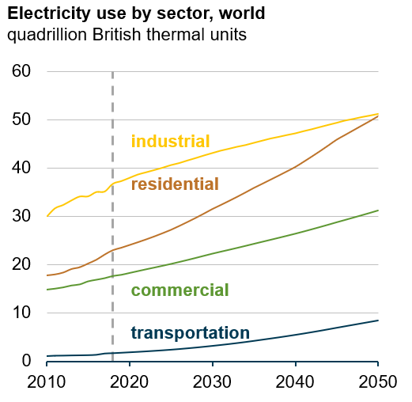
The Growing Demand for More Electricity
Electricity use in the residential and commercial sectors is predicted to grow fastest in China, India, and other countries with growing middle classes (increasing income)
International Energy Outlook 2019
https://www.eia.gov/outlooks/ieo/pdf/ieo2019.pdf
Notes:
Analysts predict increasing demand for electricity across multiple market sectors. Steady growth in the industrial and commercial sectors is driven by population growth, expansion of automation and manufacturing, growth in information and data systems, and greater use of cooling systems in commercial buildings. Transportation sees a small amount increasing growth, mainly due to the adoption of electric vehicles. The fastest growth comes from the residential sector, driven by a growing middle class with more money to spend on appliances and services driven by electricity.

Slide 6
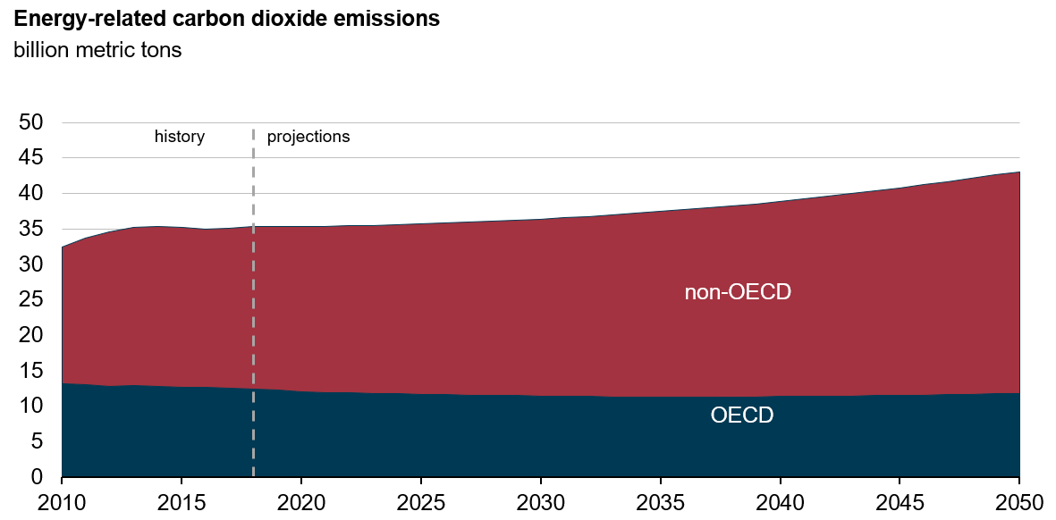
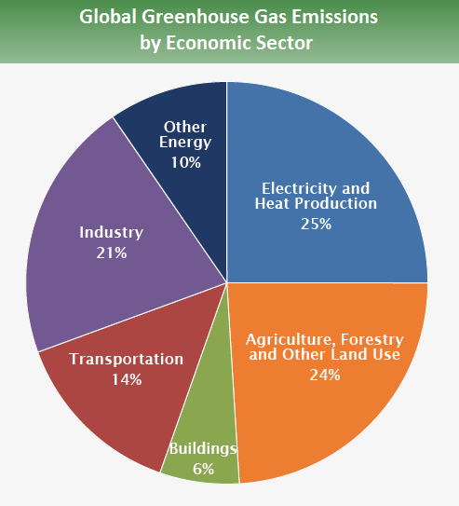
Increasing of Greenhouse Gas Emissions
OECD: Organization for Economic Cooperation and Development
United States Environmental Protection Agency
https://www.epa.gov/ghgemissions/global-greenhouse-gas-emissions-data#Sector
International Energy Outlook 2019
https://www.eia.gov/outlooks/ieo/pdf/ieo2019.pdf
Notes:
The increasing growth of greenhouse gas emissions is proven to be the main contributor to rising global average temperatures and the resulting impact in our planet’s climate. By burning fossil fuels, mainly coal, the electricity generation sector contributes about 25% of all greenhouse gases. In the category of non-OECD countries, China and India are the 2 largest contributors of CO2.

Slide 7
More Electrification Addresses these Global Trends
Increasing demand for more electricity
More Electrification is finding its way into the following markets:
Electricity generation
Transportation
Automation & manufacturing
Consumer & other products
More Electrification
Increasing emissions of greenhouse gases
Notes:
These global trends sound ominous, but governments around the world are addressing these issues through regulation and by encouraging technology investment to take advantage of cleaner and more efficient ways to produce and consume electricity.
[BUILD]
Researchers and industry are finding ways to generate electricity that does not involve burning fossil fuels, thereby reducing the amount of CO2 and other greenhouse gases produced by power plants. The transportation industries are reducing dependence on fossil fuels, also, reducing another source of greenhouse gas emissions. A third component involves improving the efficiency of equipment that uses electricity, reducing the need for more generation now and in the future.
Let’s look at each of these market areas

Slide 8
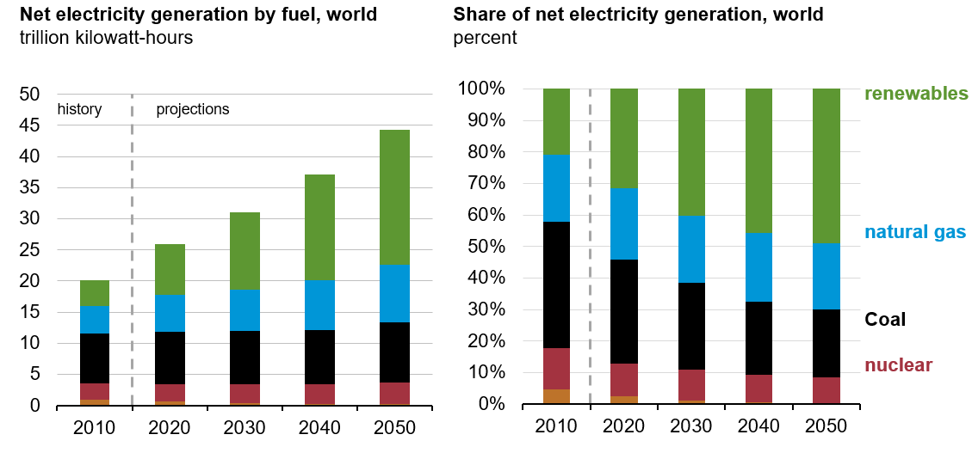
Renewable Energy – Clean Electricity – No Greenhouse Gases
Wind & solar power are projected to make up 65-70% of renewable energy production
International Energy Outlook 2019
https://www.eia.gov/outlooks/ieo/pdf/ieo2019.pdf
Notes:
Projections indicate that renewable energy will make up almost 50% of the power generation in the future.
[BUILD]
Of this, wind and solar power will provide 2/3’s of renewable energy production, with hydro power and other sources making up the remainder.

Slide 9
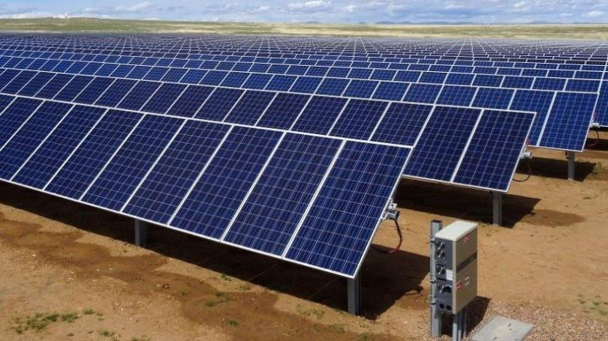
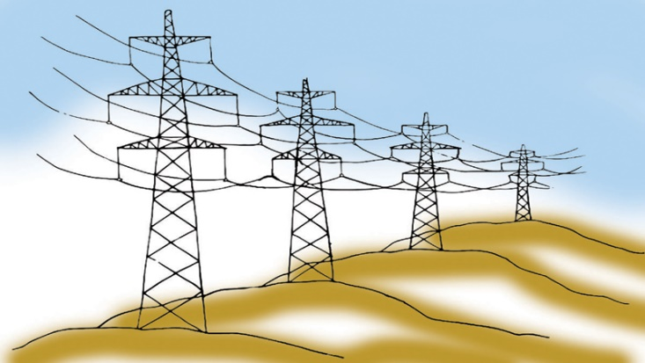


Renewable Energy – Driving Energy Storage & Transmission
Remote Solar Farm
Energy Storage & Transmission System
Population Centers
Remote Wind Farm
Notes:
Renewable energy does not produce greenhouse gases, but it does presents 2 challenges. First, it is a variable electricity source, dependent on the wind blowing and sun shining. The second challenge is that solar and wind farms are usually located away from population centers.
[BUILD]
To compensate for these challenges, the system that connects renewable energy to the power grid will require equipment for energy storage and to provide voltage and frequency support to transmit electricity from remote locations to metropolitan areas.

Slide 10
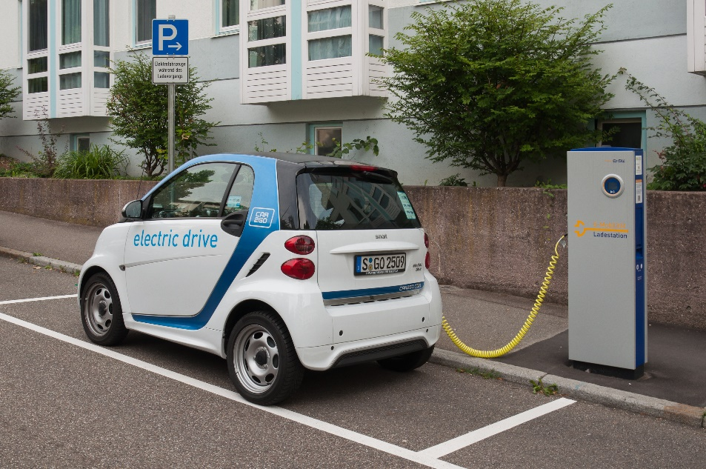
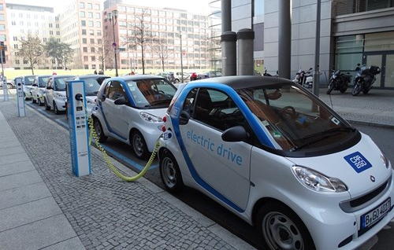
Electric Vehicles – Introducing Power Distribution Challenges
Proliferation of electric vehicles and the need to charge them will impact the electric power grid
Notes:
Electric vehicles have the potential to reduce the impact of burning fossil fuels, but adoption is predicted to grow at low rates. The positive side of electric vehicles is that the electric motor technology is less complex and more reliable than combustion engines. However, batteries are the limiting technology. Though battery cost has dropped by 80% in the last 10 years, they still fall short on a power density that does not add a weight penalty to achieve comparable range to a combustion engine-based vehicle. Another challenge will be the need for a vehicle charging infrastructure to supply electricity comparable to the system that provides fuel for today’s combustion engine vehicles.

Slide 11
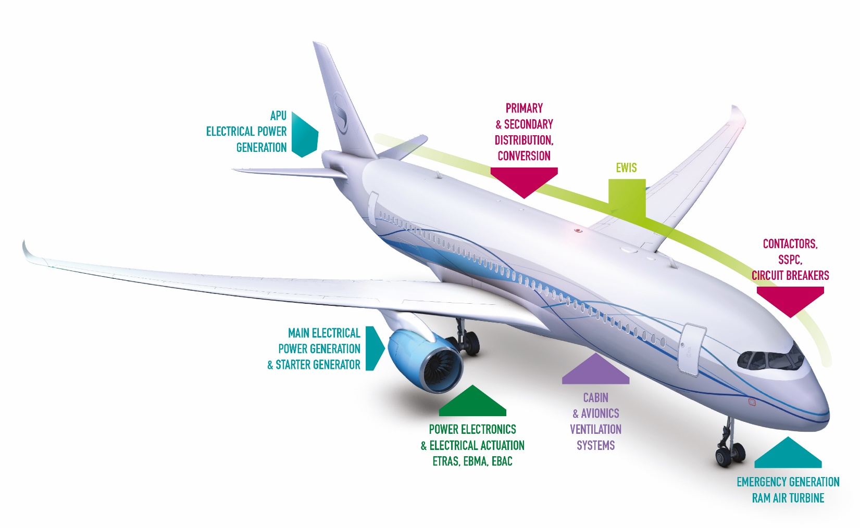
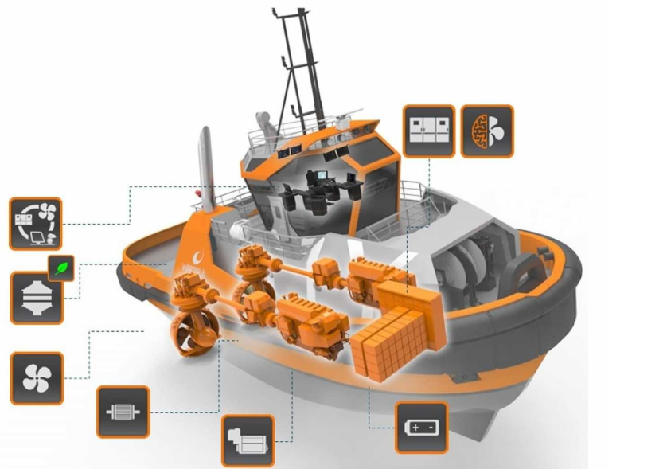
More Electric Aircraft & Ships – Better Efficiency, Reduced Emissions
Advanced electrical systems replace traditional hydro-mechanical and chemical systems
Notes:
Aircraft and marine vessels benefit from more electrification, also. Replacing mechanical systems with electric systems reduces weight, increases fuel efficiency and operating performance, and reduces greenhouse gas emissions. While fully electric aircraft may be years away, simply replacing one jet fuel driven engine with an electric driven engine can reduce a significant amount of emissions on take-offs, when aircraft burn fuel inefficiently.

Slide 12
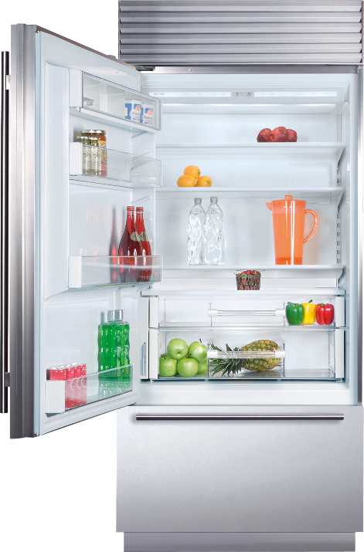
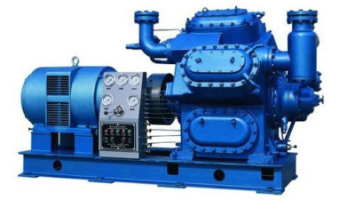
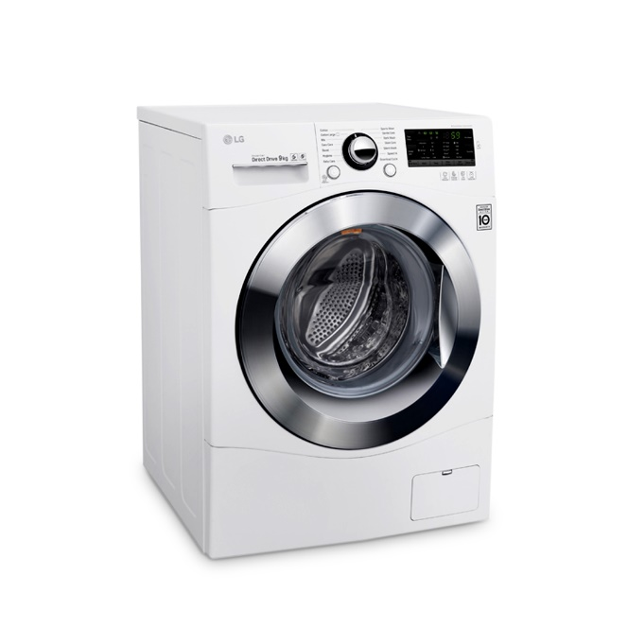

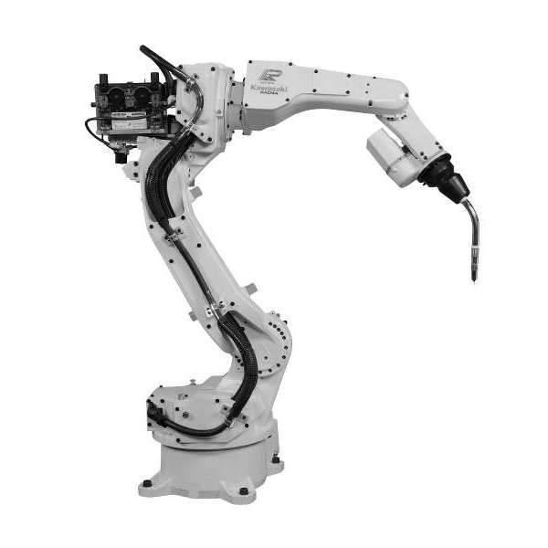
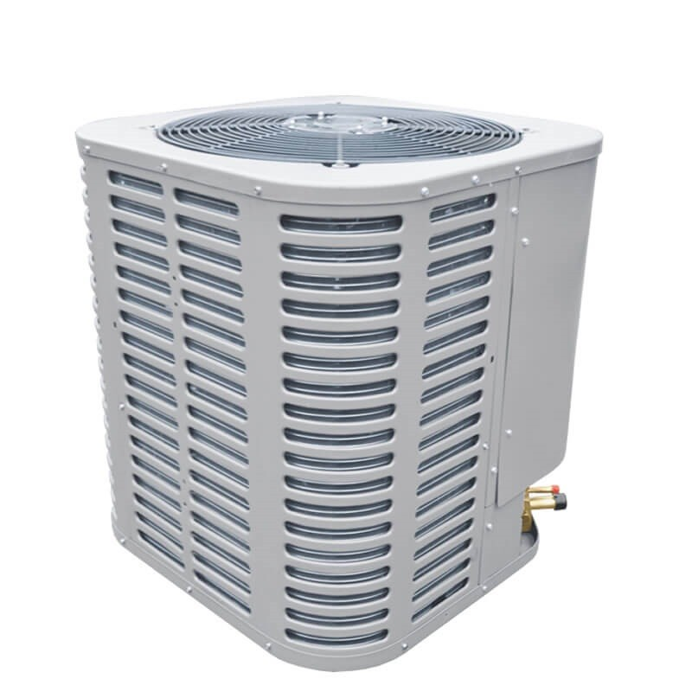
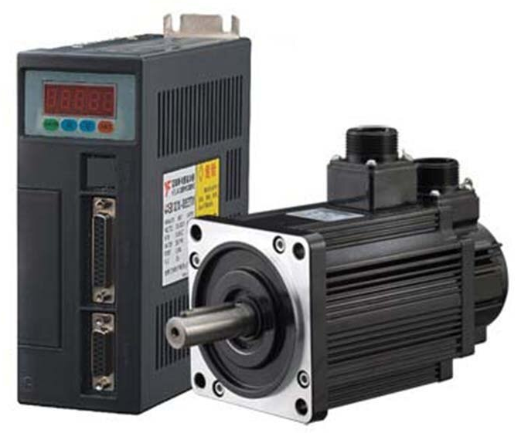
More Efficient Motors Reduce Need for Electricity Generation
Electric motors consume 45-50% of all electricity produced!
Notes:
Electric motors are everywhere and consume almost half of all the electricity produced in the world. Motor efficiency is driven by the motor’s construction and by how it is controlled. We can improve on a motor’s efficiency by controlling it to turn at a speed that matches its load and prevents it from consuming more electricity than needed.

Slide 13

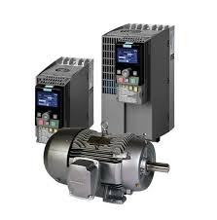
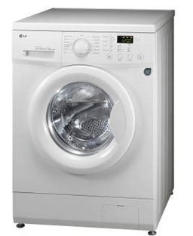
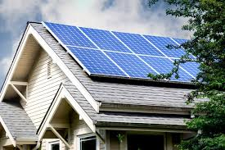
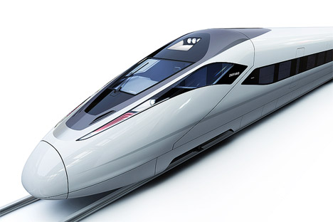
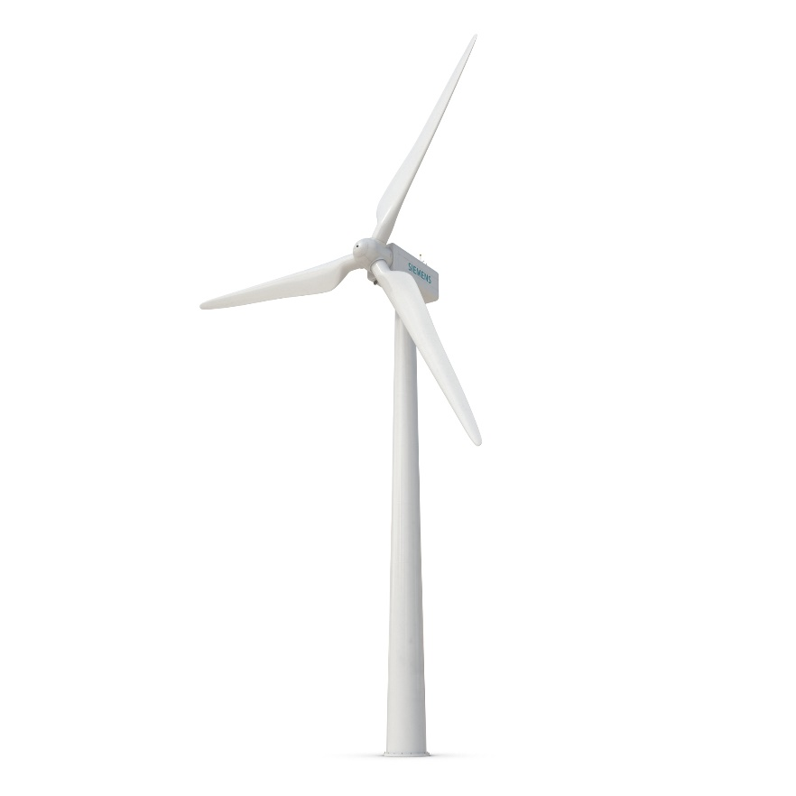
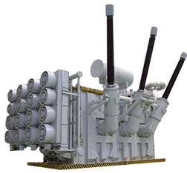
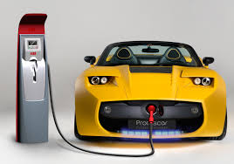
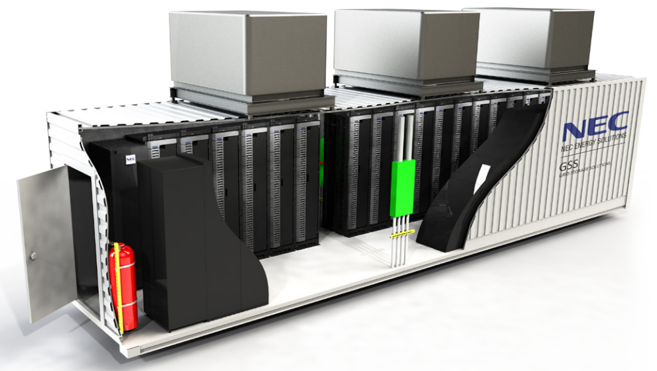
Power Electronics – An Enabling Technology for More Electrification
Notes:
All the advancements in More Electrification across transportation, consumer goods, medical products, automation systems, and energy production and transmission depend on applying power electronics. Power electronics increases the efficiency of motor systems, makes it possible to convert electricity to different forms, and to store and transmit electricity to make renewable energy sources more available.
Engineers are recognizing that More Electrification provides a greater design freedom over mechanical and chemical systems. Today, electric systems are well understood and proven reliable technology.

Slide 14
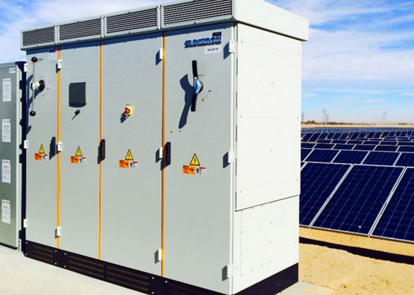

Power Electronics Need Digital Control
Power
Source
Power Electronics
Electric
Load
Electricity
IN
Electricity
OUT
Digital
Controller
DC Electricity
AC
Electricity
Solar Farm
Solar Inverter
Power Grid
Power Source
Power Electronics
Electric Load
Digital Controller
Notes:
All complex electrical systems using power electronics require digital control, which at its basis level, follow this control system structure. Electricity from a power source is transferred and converted to meet the electrical needs of a load. It’s the job of the power electronics to convert the electricity. It is the role of the digital controller to modulate the power electronics, provide supervisory control, and detect and mitigate faults.
Transmitting electricity from solar panels via a solar inverter to the power grid is a perfect example of power electronics control in action.

Slide 15
Simulink and Model-Based Design – A Better Way for Power Electronics Control Design –
Model-Based Design is the CAE approach of using system-level, behavioral simulations to develop algorithmic code for embedded software systems
With Model-Based Design you:
Design with simulation
Prototype on real-time hardware
Generate code for production
Model-Based Design helps engineers design and verify the critical software algorithms before testing on hardware
Notes:
Simulink is the modeling and simulation environment for power electronics control design that enables a complete workflow for:
Simulating control algorithms and power electronics systems
RCP and HIL testing
Generating C and HDL code for production applications
The entire workflow is supported by dedicated verification and testing tools to meet standards.
Power electronics engineers have access to MathWorks capabilities plus an ecosystem of software and hardware suppliers that build solutions that leverage Simulink.
By using Simulink, engineers use simulation to design and verify control algorithms, making errors easier to detect and correct before hardware testing.

Slide 16
Benefits of Model-Based Design for Power Electronics Control
MEASUREMENT DATA
REQUIREMENTS
Understand system behavior earlier in the project
Handle system complexity and design changes
Reduce the time for design cycles
Generate code for practically any hardware platform
Verify control algorithms using desktop and real-time simulations
DESIGN
Model Verification
Code Verification
System Verification
Use models as executable specification
Model at system level for design exploration
Integrate component models to find system integration issues and reuse IP
REAL-TIME TESTING & IMPLEMENTATION
Generate C code and HDL from models for real-time prototyping and production
INTEGRATION
Notes:
We‘ve spent some time descibing Model-Based Design, so let‘s finish by discussing the benefits.
Model-Based Design is a proven way to develop embedded control code. It lets you design and test you algorithms using desktop and real-time simulation, before you implement the code on the actual processor. You can test your code in ways not always practical or safe if you test your code using a real power electronics based system. You‘ll catch deign mistakes earlier in your development process when they are less expensive to correct.
All of our customer references tell of the time they save by using Model-Based Design. It happens because of a journey they took to change how they develop embedded sofware. The first project using Model-Based Design will take the same amount of time as their current approach. This happens because they are learning a new way to do something. However, they will find that much more time goes into design and simulation and much less time is spent of testing and re-testing. They begin to realize the time savings on subsequent projects. They have experience, confidence, and are beginning to reuse the models from their previous projects. They find a greater transparency in their designs than writing and reviewing code provides.

Slide 17
How can Power Electronics be used in the real world?

Slide 18
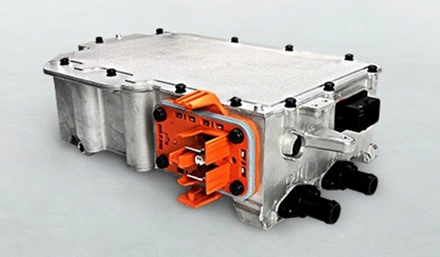
LG Electronics Develops ISO 26262–Compliant Power Inverter Control Software with Model-Based Design
Challenge
Develop inverter control software for electrical and hybrid electrical vehicles in compliance with international functional safety standards
Solution
Adopt Model-Based Design and automate production code generation, model checks, code coverage analysis, and back-to-back testing
Results
Stringent code performance requirement met
Communication improved; verification time reduced by 20%
ISO 26262–compliant software delivered on time
LG Electronics inverter for electrical and hybrid electric vehicles.
“Model-Based Design helped us apply the design and verification methods required by ISO 26262, including back-to-back verification and test coverage assessment. In particular, the automated test cases and reports in Simulink Test contributed significantly to reduced testing efforts.”
Jeongwon Sohn, LG Electronics
Notes:
Let’s look at an example that illustrates
Challenge
In the past, LG Electronics software engineers wrote embedded control software by hand based on designs created by algorithm engineers. In addition to being slow, this process was susceptible to errors stemming from communication difficulties between the different groups. LG Electronics wanted to establish a new development process in which teams used modeling and simulation to support early verification and production code generation.
Result
By using Simulink and Model-Based Design, LG Electronics sped up their process for developing and validating embedded code to meet an industry standard. Inter-team communication improved, and testing time was reduced.
Industries: Automotive
Application Areas: Control systems, Embedded systems, Power electronics control design
Capabilities: Algorithm development, System design and simulation, Embedded code generation, Physical modeling, Verification, validation, and test
Products Used: MATLAB, Simulink, AUTOSAR Blockset, Embedded Coder, IEC Certification Kit, Simscape, Simscape Electrical, Simulink Check, Simulink Coverage, Simulink Design Verifier, Simulink Test, Stateflow
Country: South Korea
LG Electronics Develops ISO 26262–Compliant Power Inverter Control Software with Model-Based Design
Automotive manufacturers are increasingly asking tier-one suppliers to deliver components developed in compliance with ISO 26262, the international functional safety standard for road vehicles. This standard covers functional safety aspects of the complete development process, including design, implementation, and verification. Many manufacturers also want their suppliers to comply with AUTOSAR standards for ECU software architectures.
LG Electronics develops ISO 26262– and AUTOSAR-compliant software for the inverter systems used to drive electric and hybrid vehicle motors using Model-Based Design with MATLAB® and Simulink®.
“Our initial objective in adopting Model-Based Design was to meet ISO 26262 recommendations,” says Jeongwon Sohn, principal research engineer at LG Electronics. “We soon discovered additional benefits to using MATLAB and Simulink, including improved communication of technical design details between engineers in disparate fields, which has led to a reduction in software defects.”
Challenge
In the past, LG Electronics software engineers wrote embedded control software by hand based on designs created by algorithm engineers. In addition to being slow, this process was susceptible to errors stemming from communication difficulties between the different groups. LG Electronics sought to establish a new development process in which teams used modeling and simulation to support early verification and production code generation.
Among the first projects to be completed with this new ISO 26262–compliant process was the design and implementation of an AUTOSAR software component for high-speed motor control. Performance specifications were stringent; the generated code needed to meet a strict execution time limit. To satisfy the project’s demanding requirements and deliver on schedule, the team needed to come up to speed quickly on the new development process.
“Model-Based Design helped us apply the design and verification methods required by ISO 26262, including back-to-back verification and test coverage assessment. In particular, the automated test cases and reports in Simulink Test contributed significantly to reduced testing efforts.”
Jeongwon Sohn, LG Electronics
Solution
LG Electronics adopted Model-Based Design with MATLAB and Simulink to develop and verify high-speed motor control software based on AUTOSAR and ISO 26262.
The LG Electronics team attended training and technical workshops conducted by MathWorks engineers, who also helped them jumpstart development with a pilot project.
The team created a plant model with Simscape Electronics™ that included an interior permanent magnet synchronous motor (IPMSM) and a switching model of the inverter’s power electronics.
Using an AUTOSAR authoring tool, the team defined interfaces and other configuration details for the controller architecture. They then exported software component description ARXML files from the authoring tool and imported them into Simulink to generate a skeleton control model.
The engineers elaborated this model, adding application logic modeled in Stateflow®. They also added a proportional-integral (PI) current controller to regulate torque, and algorithms for generating pulse-width modulated (PWM) output to modulate three-phase voltage for the vehicle’s IPMSM.
They used Simulink Check™ to find potential violations of the ISO 26262 standard and Simulink Design Verifier™ to check for divide-by-zero, overflow, and other run-time errors.
To verify the controller design, the engineers ran closed-loop simulations of the controller and plant models, using Simulink Coverage™ to measure how much of the controller model was exercised.
Next, the team generated C code from their models with Embedded Coder® and compiled the code for their target NXP™ MPC5676R microcontroller.
Using Simulink Test™, they conducted back-to-back tests of the Simulink models and generated code, as required by ISO 26262 ASIL-C, and used Simulink Coverage to assess the coverage of these tests for the generated code.
LG Electronics completed development and verification of the inverter software platform on schedule.
Results
■ Stringent code performance requirement met. “Because the code we generated with Embedded Coder was highly optimized, we were able to meet our strict execution time requirement,” says Sohn. “The generated code’s performance was comparable to that of C code written by hand.”
■ Communication improved; verification time reduced by 20%. “After adopting Model-Based Design, we saw a reduction in communication errors between teams,” says Sohn. “Because the model makes it easy to visualize the implementation, our verification time was shorter, as well.”
■ ISO 26262–compliant software delivered on time. “Semi-formal verification, control flow analysis, data flow analysis, and comparative back-to-back tests between model and code were all done using MATLAB and Simulink,” Sohn says. “Without Model-Based Design I don’t think we would have achieved our ISO 26262 compliance objectives while completing the project on time.”
Learn more about LG Electronics: www.Ig.com/global

Slide 19
Stem Accelerates Development of Power Electronics Control Systems with Model-Based Design
Challenge
Speed the development and certification of a power electronics control system for a distributed power storage system
Solution
Use Model-Based Design with MATLAB and Simulink to run simulations of power electronics, the electrical grid, and controller; generate production microcontroller code; and achieve certification
Results
Six months of development time saved
Thousands of dollars in board spin costs saved
System fully operational days after hardware becomes available
A commercial installation of Stem’s PowerStore energy system.
“With Model-Based Design we saw exactly how our controller would work with the hardware even while the hardware was being developed. After we had the hardware, refinements were easy because the simulations matched what we saw on the scope, and that gave us tremendous confidence in the design.”
David Erhart, VP, Stem
Notes:
Industries: Energy production, Industrial automation and machinery
Application Areas: Control systems, Embedded systems
Capabilities: Mathematical modeling, Algorithm development, System design and simulation, Embedded code generation
Products Used: MATLAB, Simulink, Control System Toolbox, Embedded Coder, SimPowerSystems, Stateflow
Country: USA
Stem Accelerates Development of Power Electronics Control Systems with Model-Based Design
In many areas, electricity bills for large businesses include charges for the total amount of electricity used, as well as demand charges based on peak usage. High demand for just 15 minutes can account for half the total charges on a monthly electricity bill. Stem’s distributed storage technology reduces peak loads by predicting usage patterns and deploying stored energy when needed. Recharged during off-peak hours, the batteries in Stem’s locker-sized PowerStore tower can provide up to 18 kilowatts of power on demand.
Stem designed and developed the PowerStore energy system in just 13 months using Model-Based Design with MATLAB® and Simulink®.
“We thought we were taking a development timeline risk, but hindsight has shown that Model-Based Design actually reduced risk because we could develop and debug the control system before hardware was available,” says David Erhart, VP of Engineering at Stem. “In fact, our simulations with Simulink and SimPowerSystems enabled us to make hardware design decisions. As a result, we shortened the product development cycle, completing it with just one board respin.”
Challenge
As a startup company with a small team of engineers, Stem needed to minimize time-to-market while keeping down costs for its first product. One way to achieve both objectives was to reduce board spins, which typically cost $15,000 or more each and consume weeks of the engineering schedule. To this end, Stem wanted to design and verify the control algorithms via simulation using a highly accurate plant model. The algorithms would need to control insulated gate bipolar transistors (IGBTs) that switch 24,000 times per second as they interact with the electric grid and the PowerStore batteries.
PowerStore had to be certified to the IEEE 1547 standard for interconnecting distributed resources with electric power systems and the UL 1741 standard for inverters, converters, controllers, and interconnection system equipment used with distributed energy resources. These standards include strict anti-islanding rules, which require all power-producing inverters connected to the grid to shut off within seconds after a power failure. Stem sought an approach that would enable them to streamline the certification process.
“With Model-Based Design we saw exactly how our controller would work with the hardware even while the hardware was being developed. After we had the hardware, refinements were easy because the simulations matched what we saw on the scope, and that gave us tremendous confidence in the design.”
- David Erhart, Stem
Solution
Stem engineers used Model-Based Design to accelerate the development of their flagship PowerStore product.
Working in Simulink and SimPowerSystems™, Brad Landseadel, chief power electronics engineer, and his team developed a plant model that included relays, IGBTs, inductors, DC-link capacitors, and pulse width modulators (PWMs) as well as a submodel of the electric grid.
They used Simulink and Control System Toolbox™ to model PowerStore’s advanced electronic control system, including the anti-islanding control logic. In Stateflow®, they modeled a state machine that manages faults, processes commands from a power monitor, and initiates sequences to charge or discharge batteries.
To debug and verify the control algorithm and its nine proportional-integral (PI) control loops, the team simulated the controller and the plant in Simulink. During these simulations, the team gained insights that influenced the hardware design. For example, they determined optimal inductance values and identified the need for additional relays.
The engineers generated C code from their controller model using Embedded Coder®, compiled the code in Code Composer Studio™ from Texas Instruments, and deployed it to TI’s TMS320F28335 digital signal processor.
After testing and refining the hardware and controller design, Stem began the certification process. During certification testing, the team created Simulink simulations to replicate tests not passed by their initial design.
“We updated the controller model, re-generated code, and passed the tests the following day,” says Erhart. “That capability got us through certification on our first try and at a pace about 25% faster than normal.”
Stem achieved UL 1741 and IEEE 1547 certifications from TÜV for the PowerStore system, which is now in production.
Results
■ Six months of development time saved. “The code we generated with Embedded Coder does just what it is supposed to do,” says Landseadel. “Writing code with nine PI loops in it by hand and then debugging it on hardware would have added six months or more to the schedule.”
■ Thousands of dollars in board spin costs saved. “Many companies require seven or more board respins. For our eight-layer board, a single respin costs about $25,000,” says Erhart. “With Model-Based Design, we needed just one respin before production. That saved time and potentially hundreds of thousands of dollars, which for an early-stage company is substantial.”
■ System fully operational days after hardware becomes available. “Model-Based Design enabled us to develop the controller software before we had hardware,” says Landseadel. “When our first boards came in, all the control algorithms were already in place; five days later we were delivering power with code generated by Embedded Coder.”
Learn more about Stem: www.stem.com

Slide 20
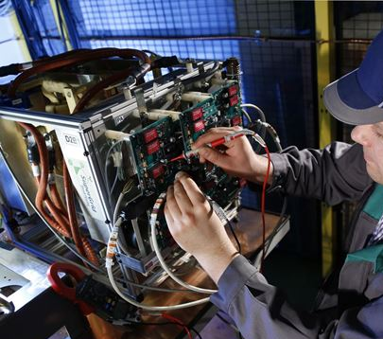
SuperGrid Institute: An efficient and compact power converter to enable the supergrids of the future
Challenge
Design and implement a DC-DC power converter using SiC transistors that would operate at 20kHz
Solution
Model-Based Design with Simulink and HDL Coder to model, verify, and implement the controller on a Speedgoat real-time target
Results
Less than 12 months to test a compact 1 kV, 100 kW DC-DC power converter with an efficiency of 98%
Fast design iterations using HDL code generation from model to FPGA
"The transition from design model to real-time software was very fast thanks to the complete compatibility between MATLAB & Simulink and Speedgoat. The Speedgoat target machine provides fast and robust control of the switching semiconductors in a difficult electromagnetic environment."
Piotr Dworakowski, Power Converters team leader

Slide 21
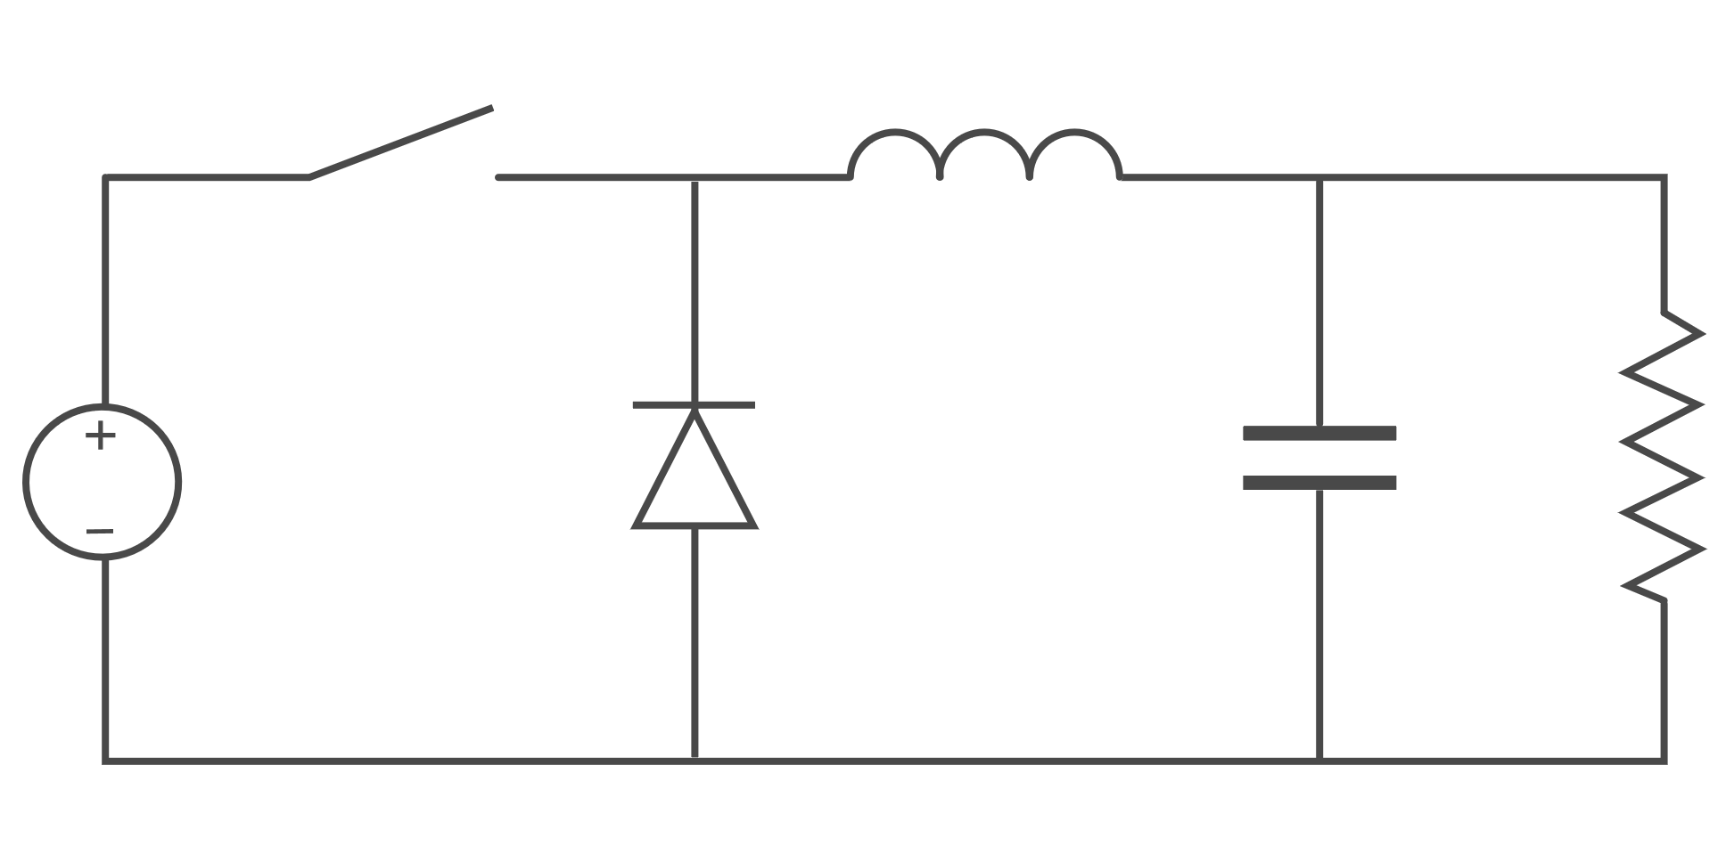
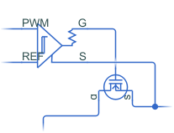
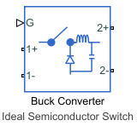
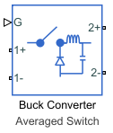
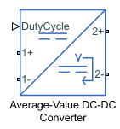
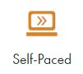
Power Electronics Simulation Onramp
Free, short course on the basics of simulating power converters in Simscape Electrical
Brief videos & hands-on exercises
Automated assessments & immediate feedback
Access online or from Simulink (R2022b or later)
Topics include:
Simulate a buck converter circuit using Simscape Electrical
Model the buck converter at varying levels of fidelity to balance detail and simulation speed
Implement closed-loop voltage control for the buck converter
High
Fewer approximations
Slower simulation
Low
More approximations
Faster simulation
Model fidelity
Modeling scope
Detailed
High-level
Switch
Converter
Subsystem
System

Slide 22
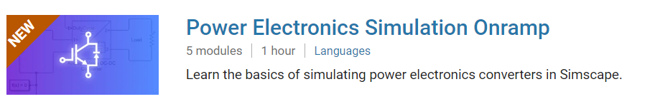
TO DO
Go to https://matlabacademy.mathworks.com/
Log in to your MathWorks account
Launch Power Electronics Onramp

Slide 23
Prizes
Complete at least 50% of Power Electronics Onramp to be eligible for any prize
Bring your laptop when you come to collect the prize
Follow Us on Facebook!
Find us on Facebook at [Insert Facebook Group Name]

